Slide 1
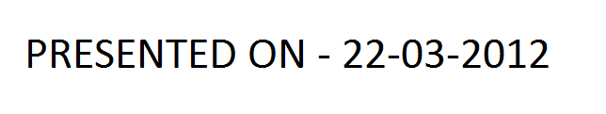
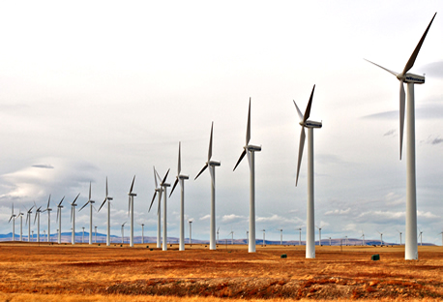
Wind Energy Systems
History , Technology , Simulation
Presented by
-- M.Senthil Kumaran
ZnTill [ ]
Value has a Value only if its Value is Valued
- Bryan Dyson – Former CEO -Coca Cola

Slide 2
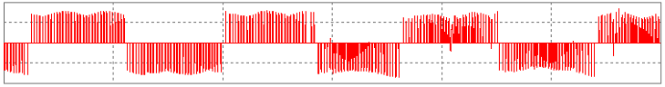
Inspiration …………..
Lecture on Wind Energy Systems
- Dr Krishna Vasudevan [ IITM]

Slide 3
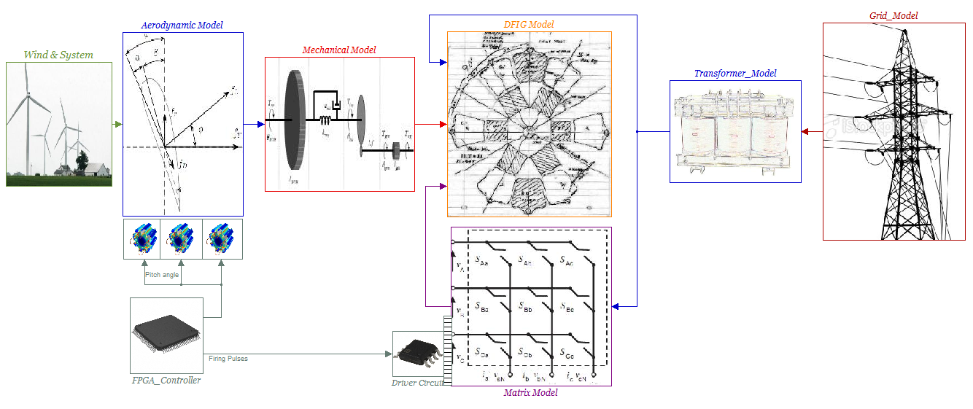

Slide 4

WIND POWER - HISTORY

Slide 5
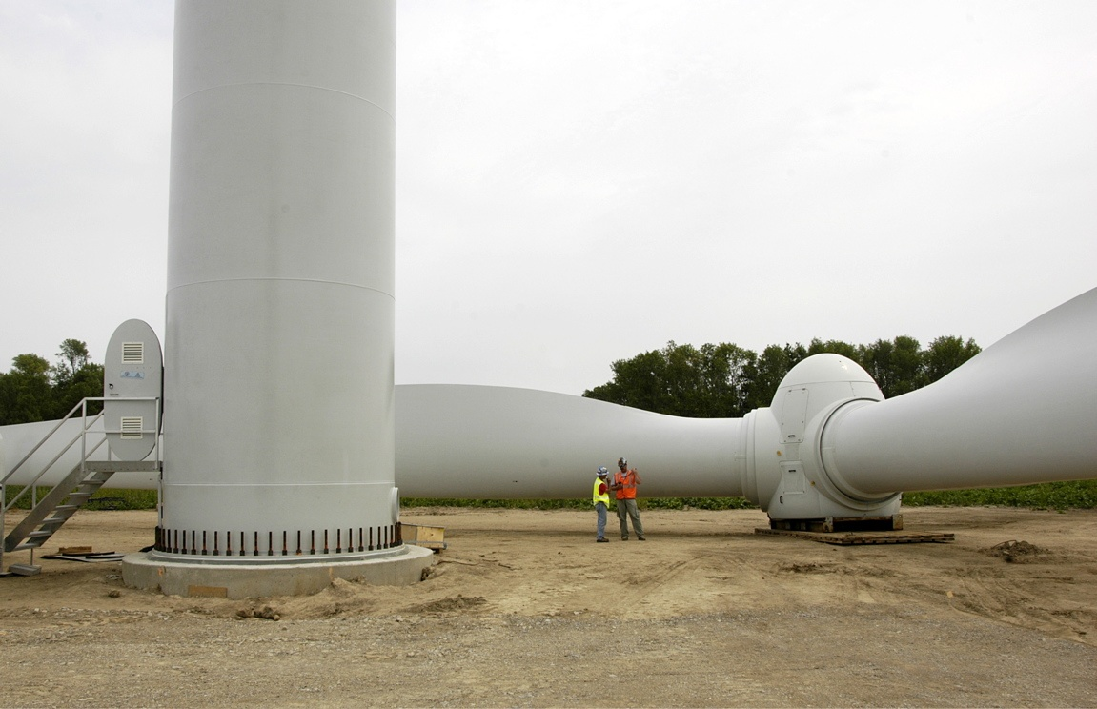
WIND POWER IN INDIA
India was the first country in Asia to Develop wind power on a commercial scale.
India has installed 10926 MW of Wind Power

Slide 6
Wind Potential in India
In 1990s
National Wind Power Potential of India estimated
20,000MW
Recently
Indian Wind Energy Association assessed the potential
Based on current MW sized wind turbine as
100,000MW
Which means there is still a large resource to be tapped

Slide 7
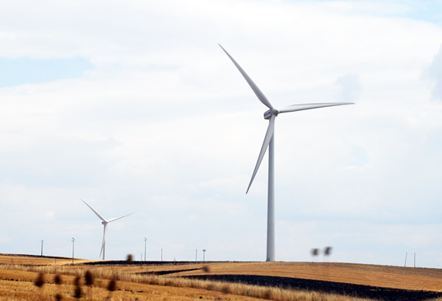
The first failure and the success story..
In 1985 – Veraval in Gujarat
40KW – brand Polanko from Netherlands jointly with GEDA
This first try was a failure because of technical problems
In 1986 – Okha in Gujarat ||Tuticorin in Tamilnadu
10 No – 55KW – Vestas || - 55KW - RRB
In 1987th
RRB and Vestas made a joint venture and formed
VestsRRB(India) Ltd and setup a wind turbine factory in
Chennai

Slide 8
Government hand and its Policies
In 1990 – Policy to promote Wind power
Package of incentives to create attractive investment
climate for wind power
*Accelerated depreciation of 100% in first year of
investment in wind power
Later Tamil Nadu Electricity Board
Banking and wheeling of electricity for wind farm
In 1998 – CWET ( Center for wind energy and technology )
Under the control of MNRE in collaboration with Risoe
National Laboratory in Denmark.

Slide 9
CWET – Its Function in Wind Energy
Technical Focal Point for Wind power development in
India
Departments
Research and Development
Wind resource assessment
Wind turbine testing
Standards and Certification
Information training and commercial services
Crucial role
Developing domestic wind turbine manufacturing
industries

Slide 10
CWET Funding in SSN College of Engineering
From the Department of Research and Development
STUDY AND CONTROL OF WEAK GRID CONNECTED MATRIX CONVERTER BASED DFIG SYSTEMS
Principal Investigator – Dr Ranganth Muthu

Slide 11
TECHNOLOGY OF WIND POWER

Slide 12
Types of Wind Energy Conversion Systems
Speed
Fixed Speed Wind Energy Systems. [ Converter less]
Variable Speed Wind energy Systems. [ Converter Based]
Power Converter
Wind Energy Systems Employing Full Converters [PMSG , SCIG]
Wind energy Systems Employing Partial Converters. [DFIG]
Electrical Machine
Wind Energy Systems Employing PMSG.[WSWECS]
Wind energy Systems Employing IG. [WSWECS or FSWECS]

Slide 13
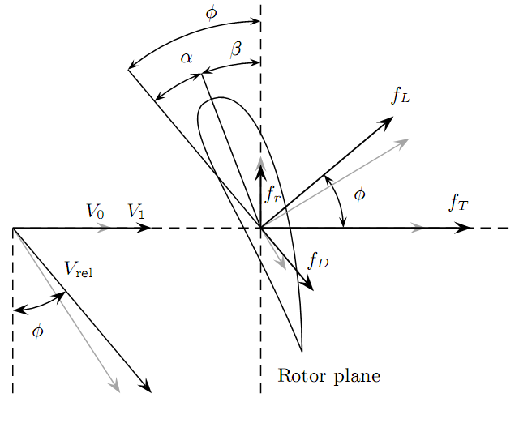
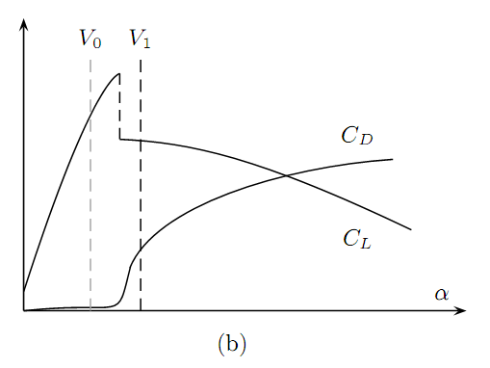
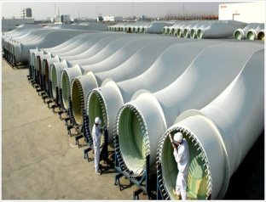
Blade Theory
Angle of incidence increases as velocity of wind increases.
Airﬂow ceases to be laminar and creates a wooing effect on the aerofoil.
This induces a deferential pressure that reduces the lift and increases abruptly the drag.
Changes in lift fL and drag fD forces lead to a large increment in the axial thrust force fT whereas the tangential force fr decreases slightly.
As a result, the aerodynamic torque and power decrease. It is said that the turbine stalls. An undesirable consequence of stall regulation is the increased thrust that causes heavier aerodynamic loads.

Slide 14

Why Go from FSWECS to VSWECS
& from Fixed pitch to Variable pitch
It sees from blade theory stall regulation happening in FSWECS increases thrust that causes heavier aerodynamic loads.
Poor Operating efficiency – Because of uncontrollable angle of incidence in Fixed Pitch system - [ Power coefficient comes down for high TSR]
Advantage-
Cheap and Dose not contain any Power Electronic Systems – Employs SFIG

Slide 15
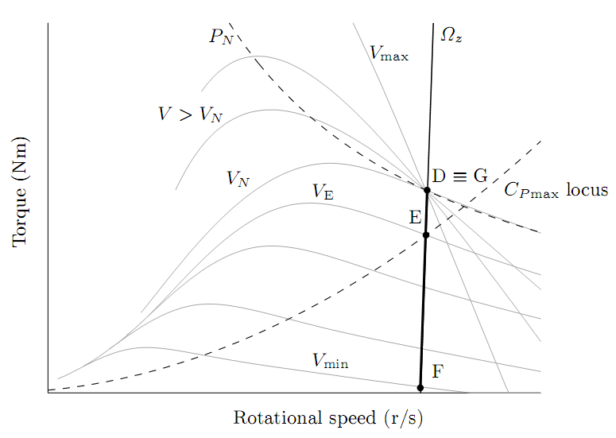
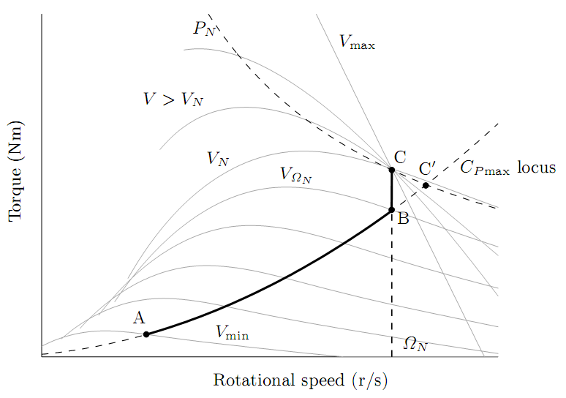
Why Go from FSWE to VSWE - Diagrammatic
Variable Speed WECS
Below rated Wind Speeds it operates with variable speed to give max η
At higher wind speeds it operates with variable pitch to give max η
Fixed Speed WECS
At only one wind speed it works with max η
At higher wind speeds Stalling happens . – Less Power

Slide 16

Why Go from Full Converter to Partial Converter based System
In a Full converter the entire power has to be handled by the converter
More Cost
Which leads to more switching losses
More stresses on Power Electronic Devices
Poor Efficiency – Less wind speed range of operation
In Partial Converter the only 30% of the entire power is handled
Less Cost
Less Switching Losses
Less Stresses on the Power Electronic Devices
Greater Efficiency – wide wind speed range of operation
Disadvantage
DFIG Employs Slip Rings for Rotor control which leads to sparking

Slide 17
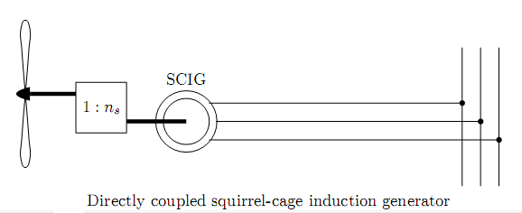
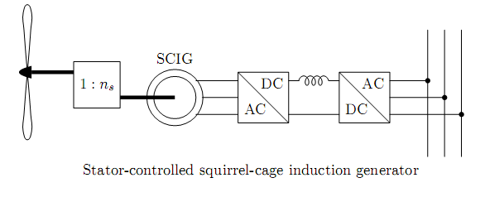
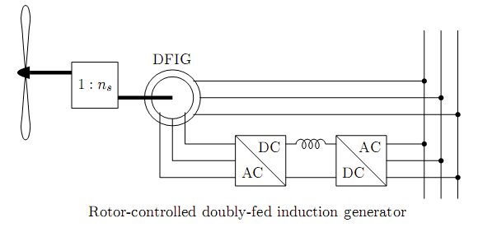
Why Go from Full Converter to Partial Converter based System -Diagrammatic

Slide 18
Wind System Modeling

Slide 19
WIND POWER MODELING

Slide 20
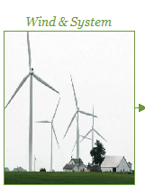
Wind Model
Stochastic Method of Wind Generation
Simulation would look Dynamic
Real Time Wind Database
Simulation Will encounter the same situation in multiple runs

Slide 21
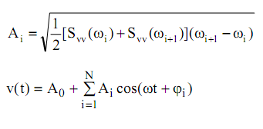
Wind Model
Stochastic Method of Wind Generation
Van der Hovens Architecture
Steady State [ Mean Flow] – ƒ(Elevation)
Turbulence [Random Flow] – ƒ(Space)

Slide 22
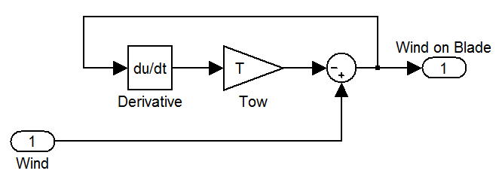
Wind Speed Damping at the Blades
A LOW PASS FILTER
Time constant can be selected from Datasheet of the Turbine manufacturer

Slide 23
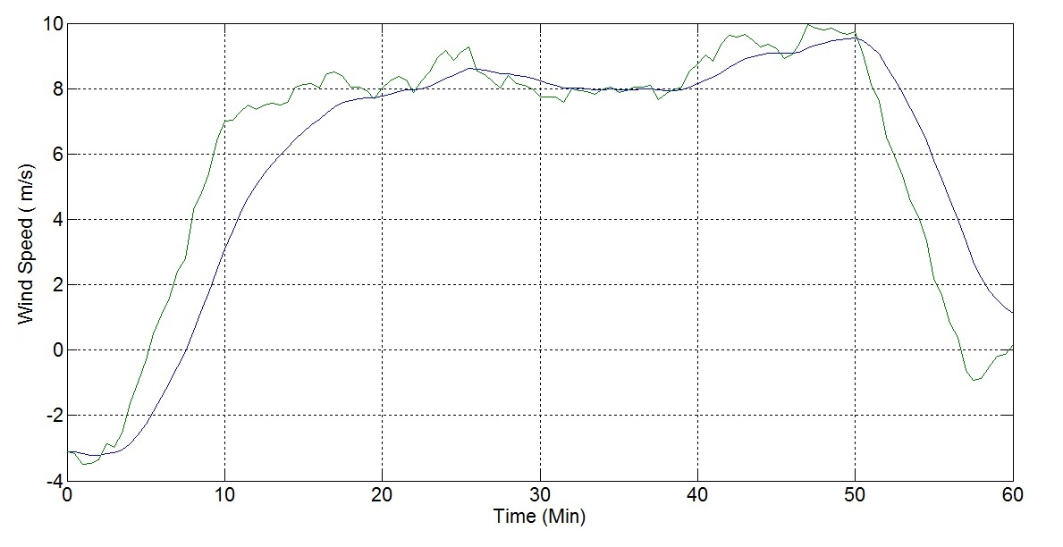
Wind Speed Seen by the Blade
Actual Wind Speed
Van der Hovens Architecture Based Wind Generation

Slide 24
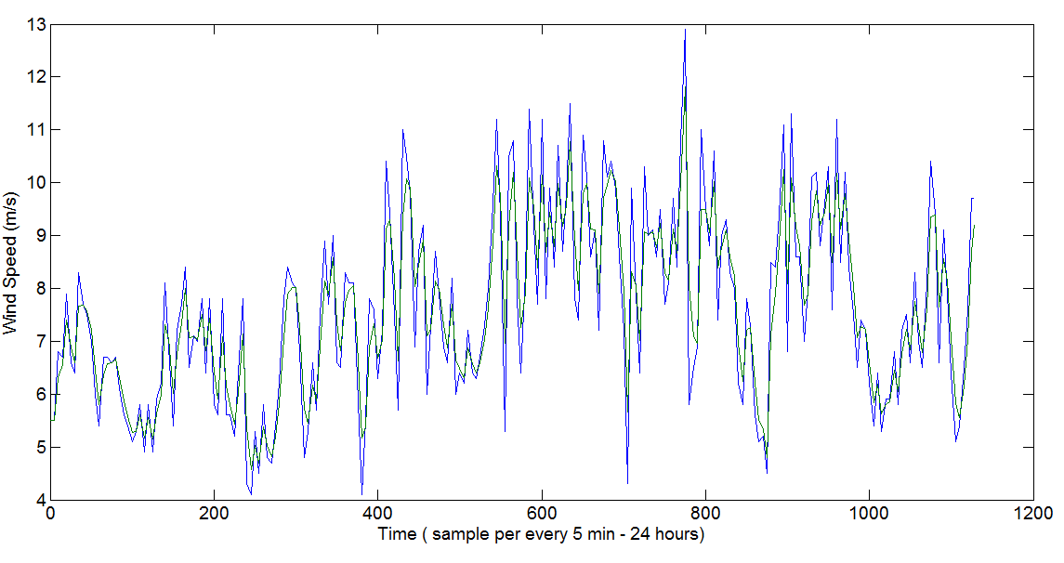
Actual Wind Speed
Wind Speed Seen by the Blade
Wind Generation Based on Real Time Wind Database – from Design Desk [ Testing unit Maharashtra]

Slide 25
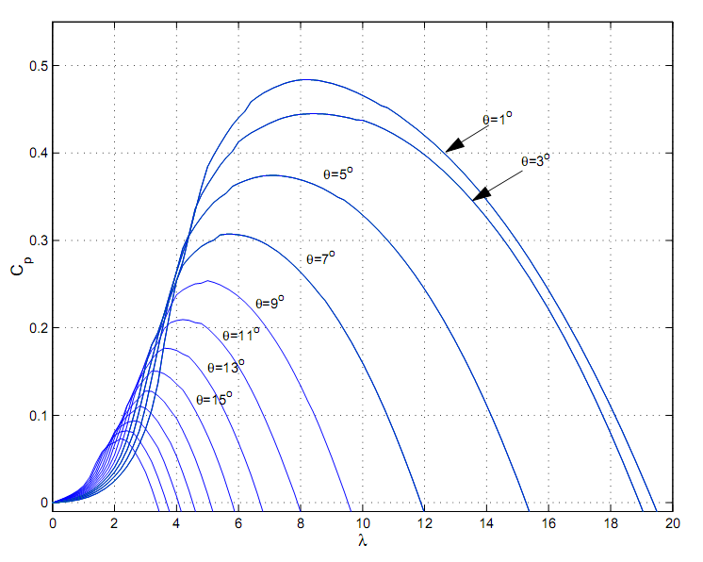
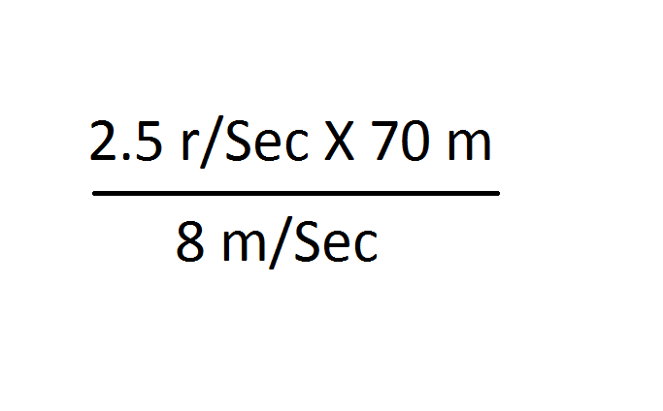
Power Co-efficient – Cp(β,λ)
Cp – Depends on the blade design of Individual
Manufactures
β = Pitch Angle
λ = Tip Speed Ratio
λ =
Tip Speed
Wind Speed
ωR
λ =
V

Slide 26
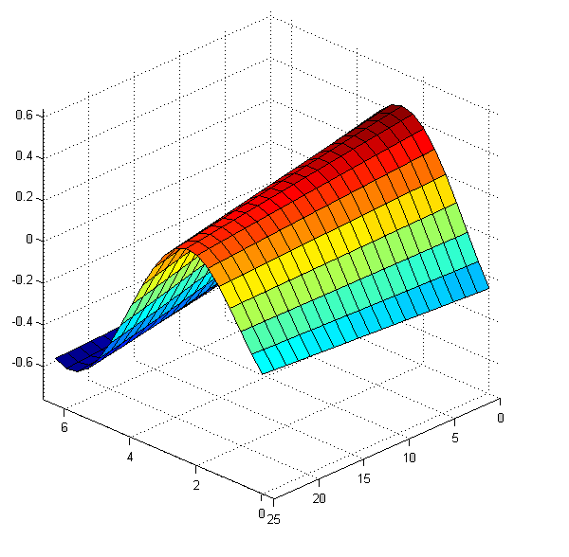
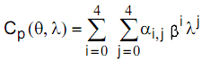
Cp(β,λ) Of GE 1.5 MW Turbine
Where
αij = constants for curve fitting described by manufacturer

Slide 27
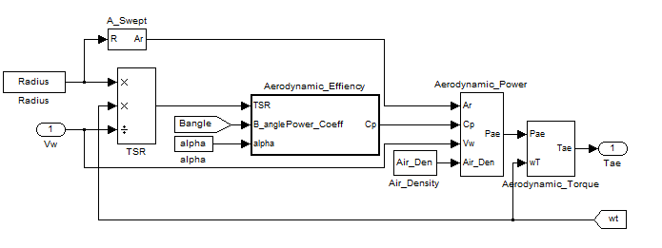
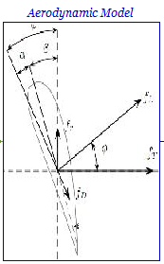
Aero Dynamic Model
P_{ae} = ρ A_{r}V³ C_{p}(β,λ) / 2
T_{ae} = P_{ae} / ω_{T}

Slide 28
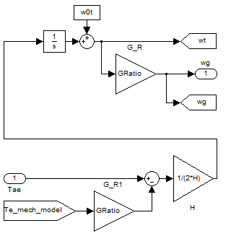
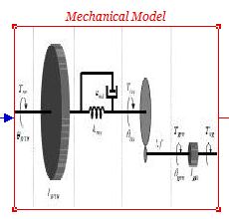
Mechanical Model
1) One Mass Model
Recommended for Simulation Studies & used in most of the work
2) Two Mass Model
Not Recommended for Simulation Studies – Slows down the simulation time
H = (½) J (dω_{mecN}²/P_{N})
Tae-Te = 2H*(dω/dt)

Slide 29
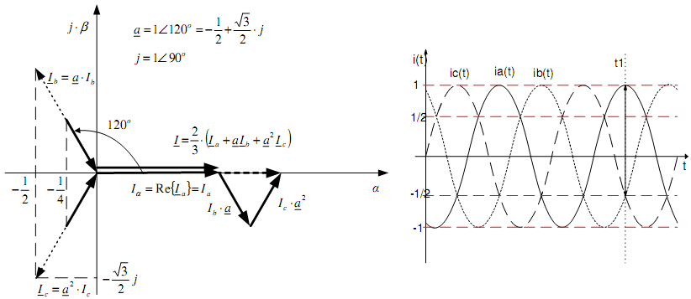
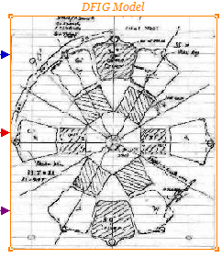
DQ Modeling for Machines
Space Vector formulation from a 3Phase System
I = [i_{a} – ½(i_{b}+i_{c})] +j[ [√3/2]*(i_{b}-i_{c})]

Slide 30
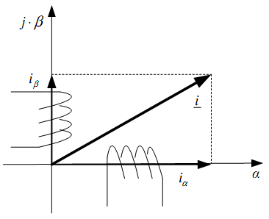
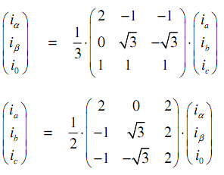
DQ Modeling for Machines
Clark Transformation (α,β,0) – (a,b,c)

Slide 31
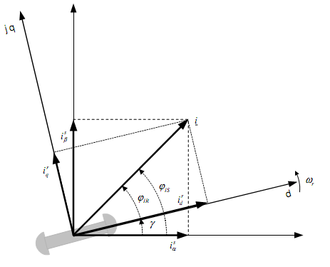
DQ Modeling for Machines
Park Transformation (d ,q,0) – (α β,0)

Slide 32
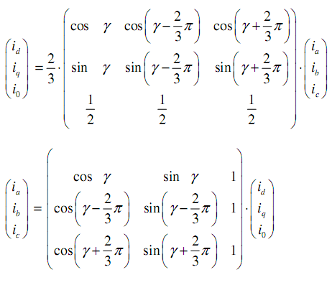
DQ Modeling for Machines
Park Transformation (d ,q,0) – (a, b,c)

Slide 33
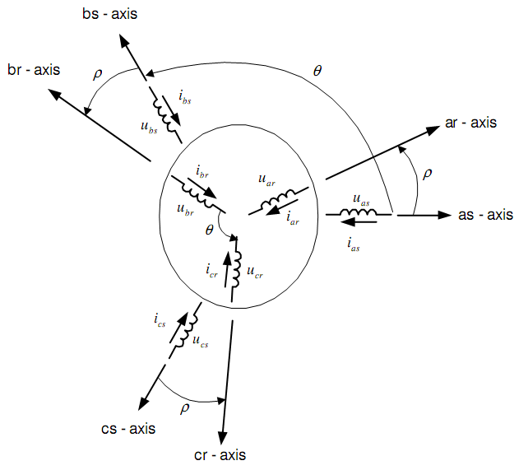
DQ Modeling for Machines
Why Design Machine in DQ
The mutual inductance between stator & rotor coils are time dependent in abc frame of reference.
BUT
Transformation leads to elimination of time varying inductance in the voltage equation of induction machine

Slide 34
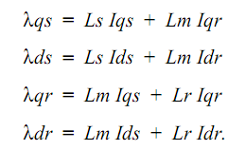
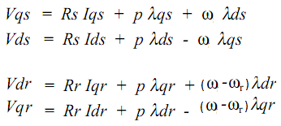
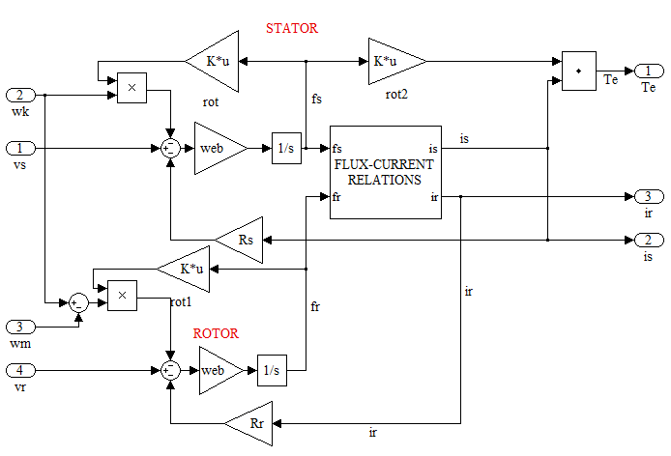
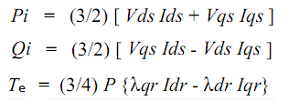
Doubly Fed Induction Generator Model
Machine Equation in arbitrary frame of reference

Slide 35
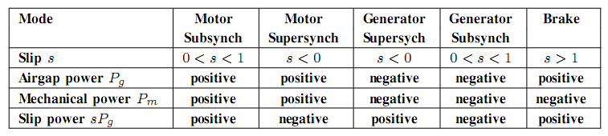


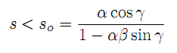
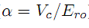
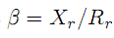
DFIG - Modes of Operation
Modes used in the work
Condition for Sub Synchronous operation of DFIG
Where
E_{ro =} Rotor Induced voltage at stand still
V_{C =} Converter Terminal Voltage
γ ₌ Phase angle

Slide 36
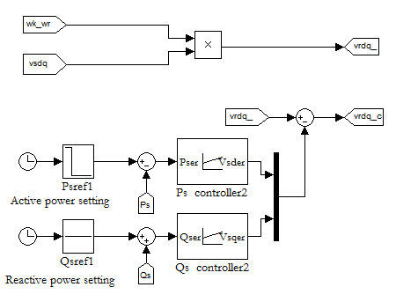
Controller Design
Stator Power and Rotor Power - Controller Design [1]
Sub Synchronous Operation Mode
Two PI Controllers With the error signals generate rotor voltage Reference signal for the Converters Modulation Algorithm
Note:
Variable Speed Operation – Under Rated Wind Speed

Slide 37
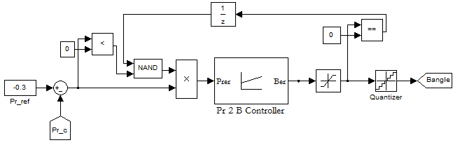
Controller Design
Pitch - Controller Design [2]
Super Synchronous above Rated Wind Speed
One PI Controllers With the error signals generate Beta for the Pitch Actuator to Shed aerodynamic power to operate at better Cp
Note:
Variable Speed Operation – Under Rated Wind Speed

Slide 38
DFIG Based WECS - SIMULATION

Slide 39
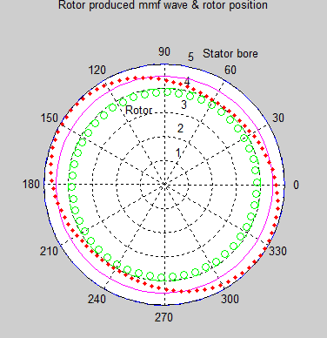
Simulation Setting
Settings for Simulation - I
Stator Active Power = 1 PU
Stator Reactive Power = 0 PU
Rated Converter Power = 0.3 PU
Pitch angle Increment = 1⁰
Rated Wind Speed = 12 m/s
Wind Speeds = 11 , 16 ,11 ,9m/s
Control = Pitch [Mech]+ Vector[Electrical]

Slide 40
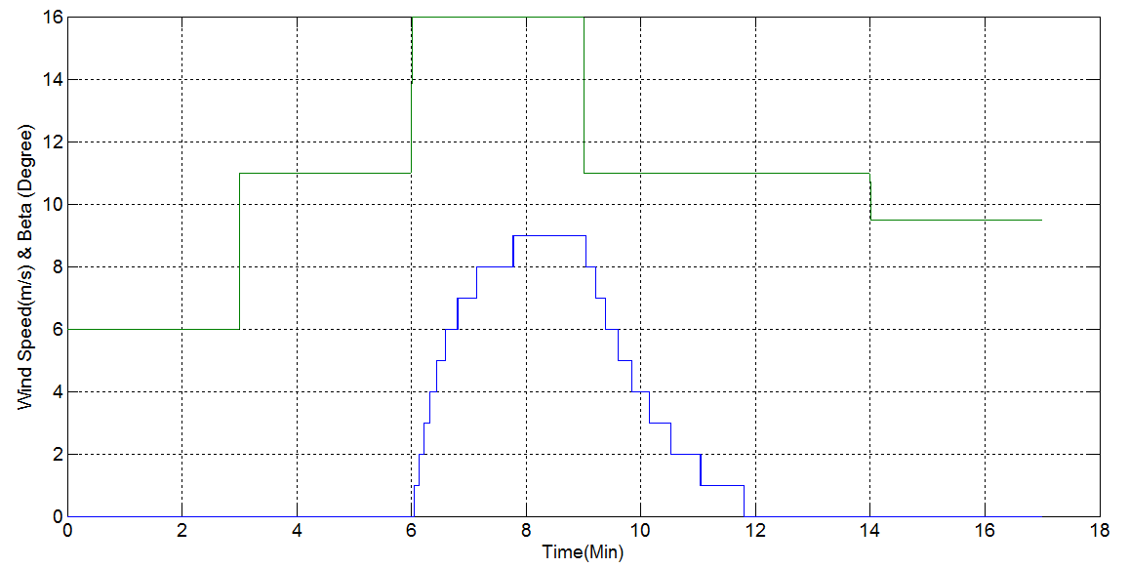

Slide 41
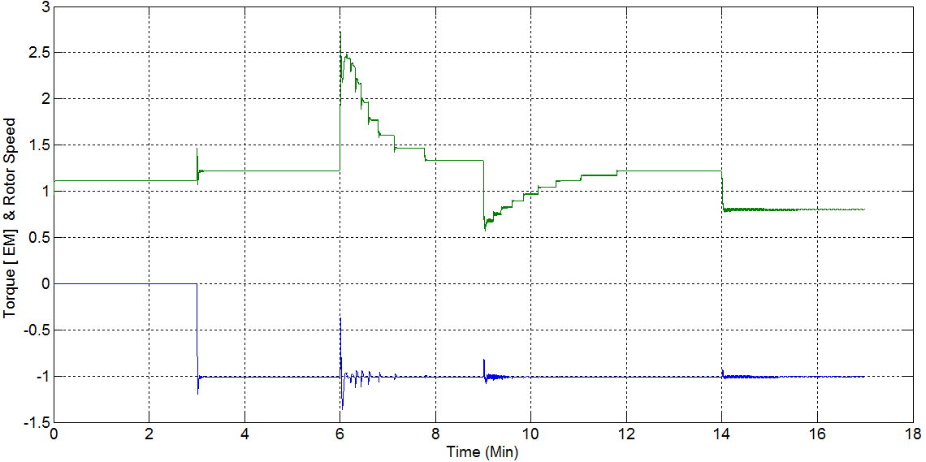

Slide 42
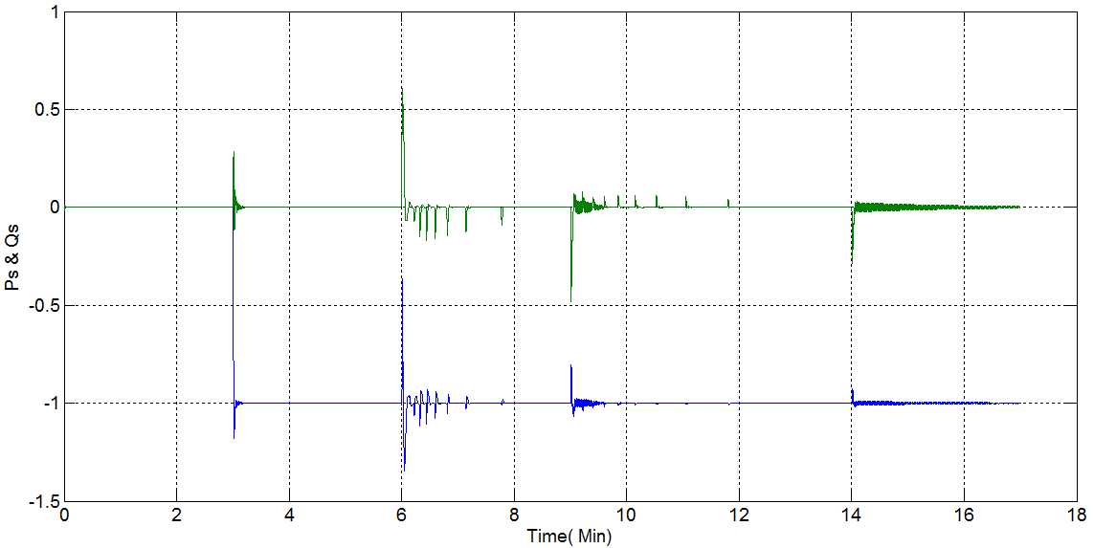

Slide 43
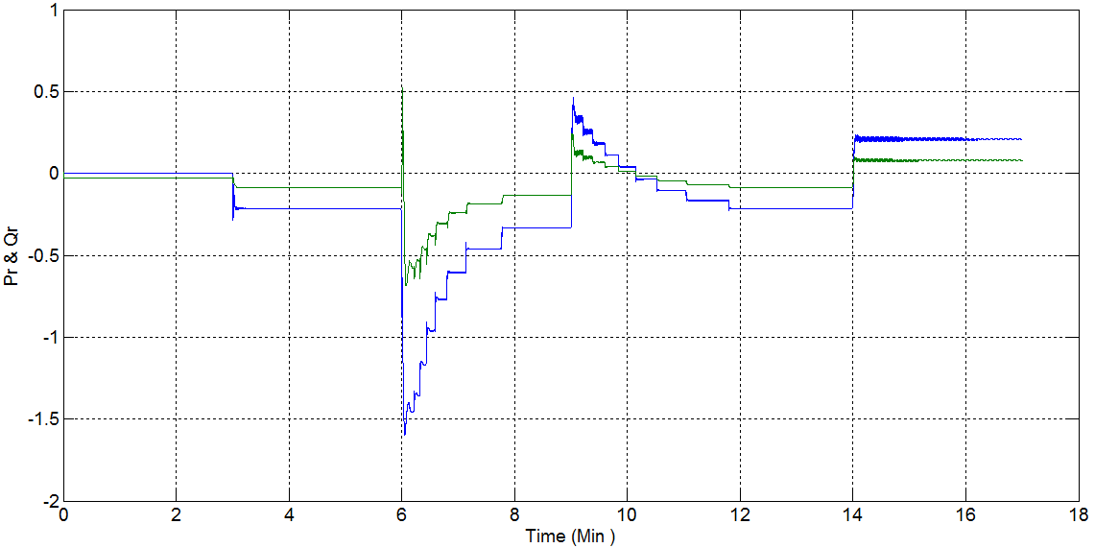

Slide 44
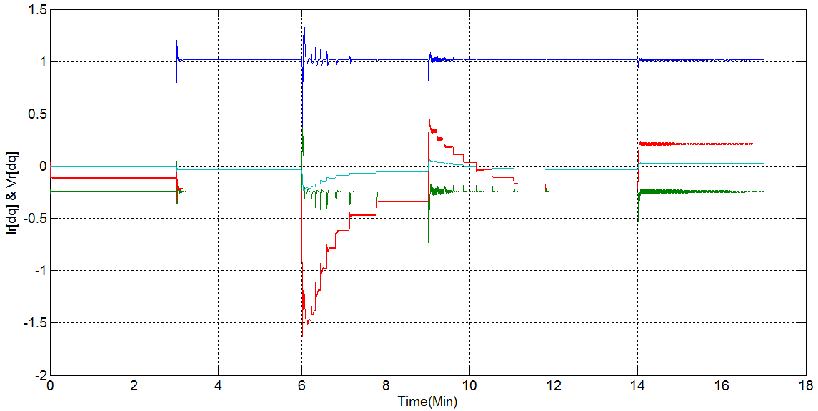

Slide 45


Slide 46


Matrix Converter 3Phase to 3Phase

Slide 47


Indirect Space Vector – Modulation – For MC
Reference – [9]

Slide 48

Simulation - Converter
Output Voltage

Slide 49

Simulation -Converter
Input Current

Slide 50

Simulation - Converter
Output Current

Slide 51


Simulation With a Converter in DFIG systems
converter Switching frequency 12KHz

Slide 52

Simulation With a Converter in DFIG system

Slide 53

Simulation With a Converter in DFIG systems

Slide 54

converter Voltage Out put – fed to Rotor

Slide 55

HARDWARE OF THE ROTOR SIDE CONVERTER

Slide 56
Hardware - Design
Used….
Eagle software – For PCB Design
Spartan 3E Nexys 2 Board – for controller coding
Xilinx 13.2 Software - for Controller coding in FPGA
Power Module Construction With 60Amp , 1200 Volt - IGBT
SK60GM123
CONCEPT SCALE Driver IC –> 6SD Series - for IGBT DRIVER CIRCUIT

Slide 57




Hardware – Power Module
Construction of MC using SK60GM123 IGBT Modules and Solid Copper Bars.

Slide 58


Hardware – Firing Circuit
Low Power Matrix Converter Setup
230/24V 3 Ph Tf
Low Power MC Module
15V supply for Isolation Circuit
Gating pulses from PC
Totem Pole Gate Driver

Slide 59


Hardware Firing and FPGA Circuit
CONCEPT board Switching
Implementation of the new algorithm in FPGA

Slide 60

Converter setup

Slide 61




Direct AC –AC Converter {Variable Frequency System } Output
A Phase Voltage
B Phase Voltage
C Phase Voltage
Three Phase Output Voltage Waveform
Scope: Agilent Technologies Load: 120W Lamp Load Supply: 3 Ph 24V

Slide 62





A Phase Voltage -25 Hz
A Line Voltage -25 Hz
Common Mode Voltage
A Phase Voltage – 50Hz
A Line Voltage – 50Hz
Scope: Agilent Technologies Load: 120W ResistiveLoad Supply: 3 Ph 24V

Slide 63
Thank You

